Slide 1

Spring Data with JPA

Slide 2

Hitting the database with Spring and JDBC

Slide 3
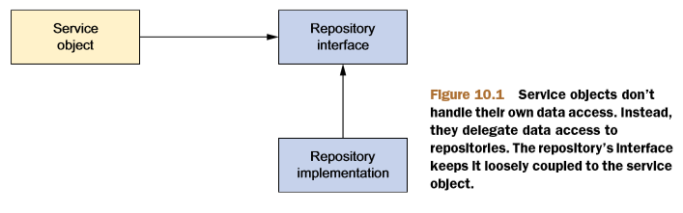
Spring´s data-access philosophy

Slide 4
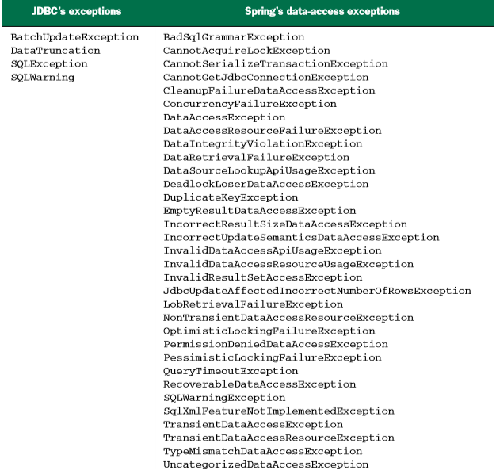

Slide 5
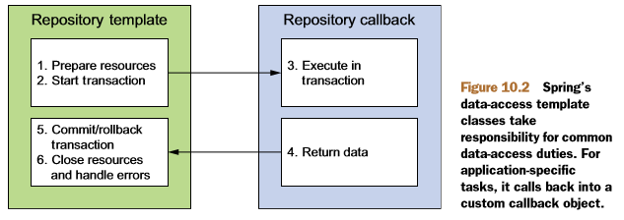
Templating data access

Slide 6
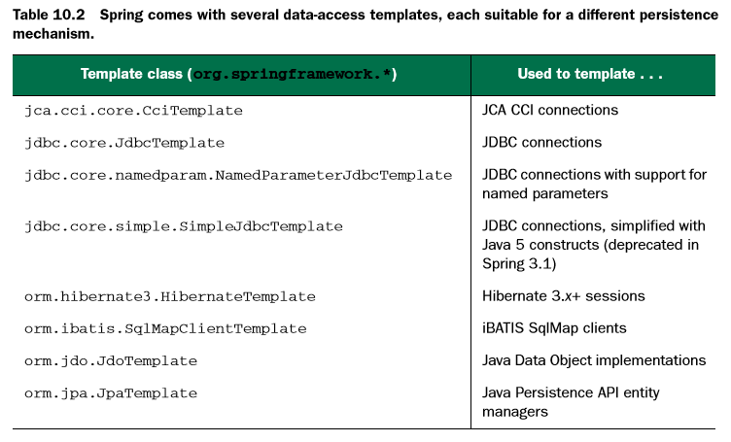
Templating data access

Slide 7
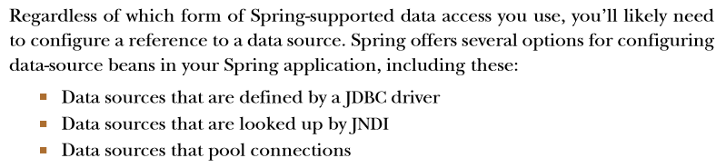
Configure a data source

Slide 8
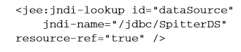
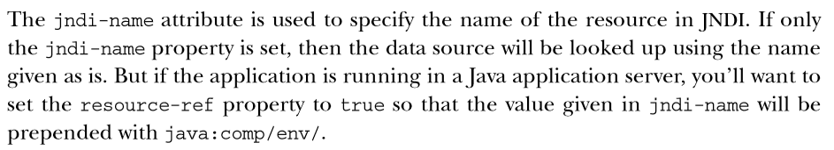
Using JNDI data sources

Slide 9
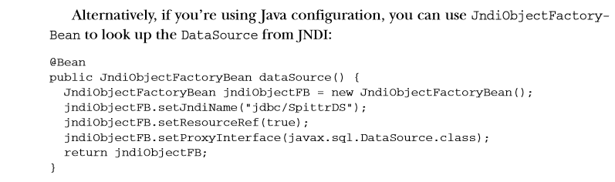
Using JNDI data sources

Slide 10
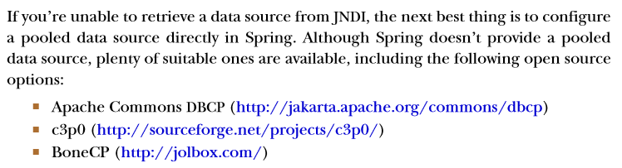
Using a pooled data source

Slide 11
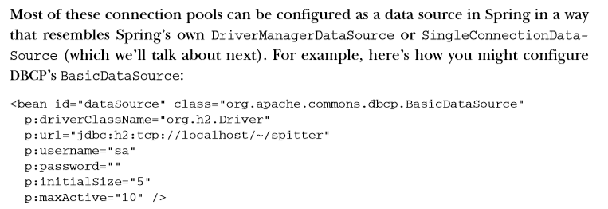
Using a pooled data source

Slide 12
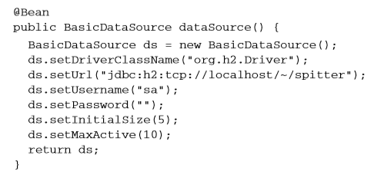
Using a pooled data source
Or in Java-Config:

Slide 13
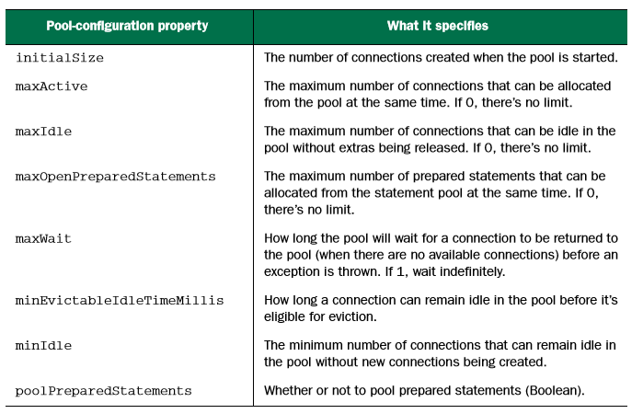
BasicDataSource´s pool-configuration properties

Slide 14
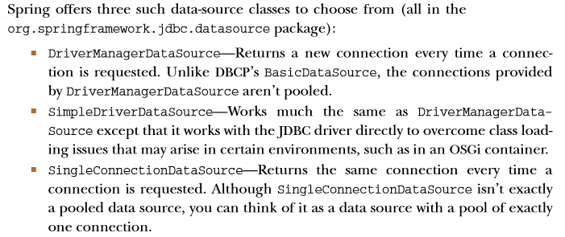
Using JDBC driver-based data source

Slide 15
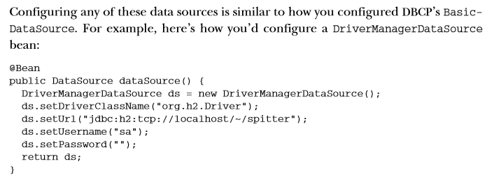
Using JDBC driver-based data source

Slide 16
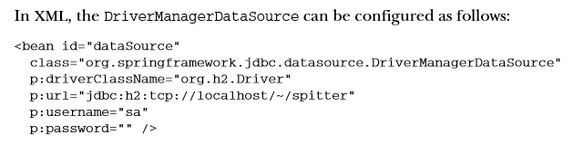
Using JDBC driver-based data source

Slide 17
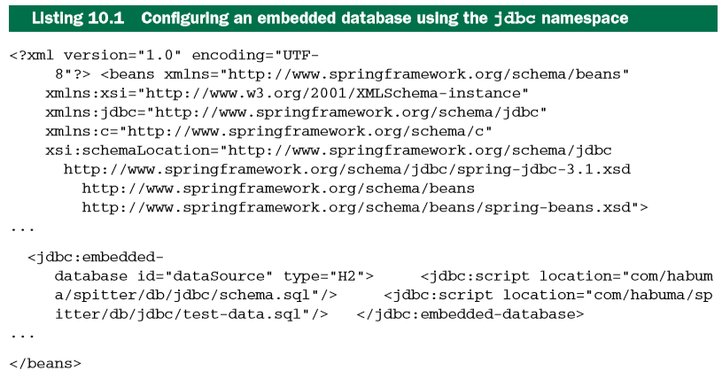
Using an embedded data source

Slide 18
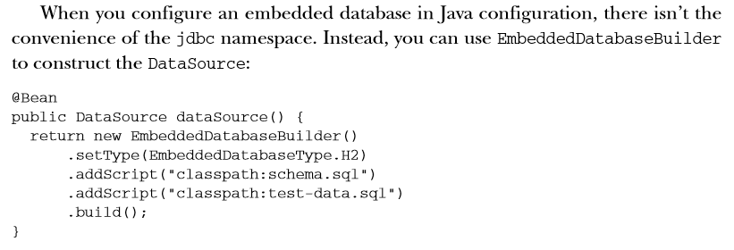
Using an embedded data source

Slide 19
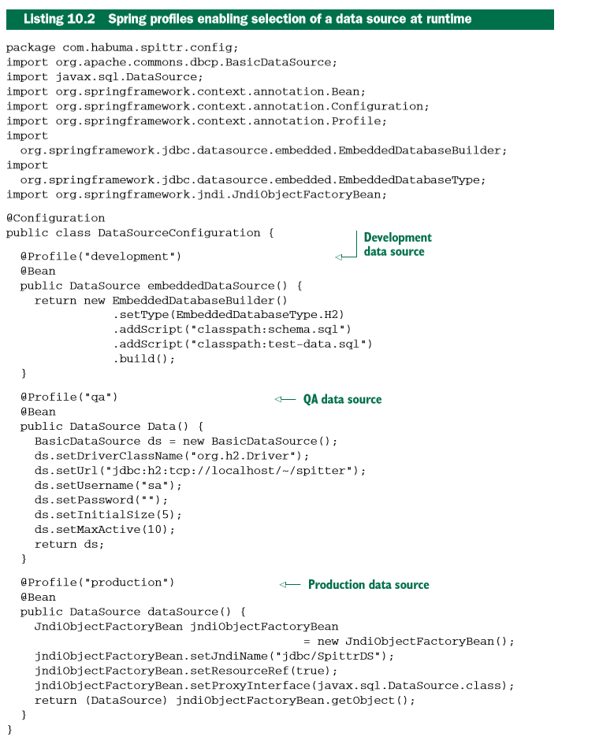
Using profiles to select a data source

Slide 20
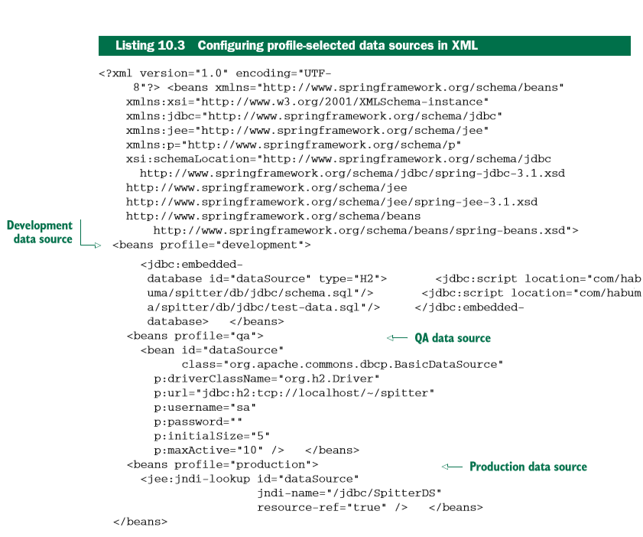
Using profiles to select a data source

Slide 21
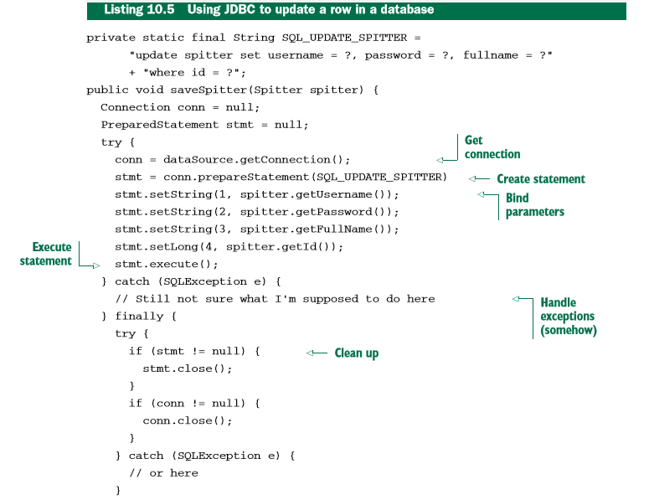
Using JDBC with Spring

Slide 22
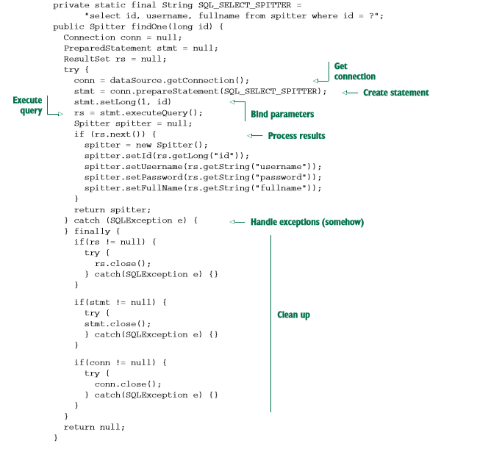
Using JDBC with Spring

Slide 23
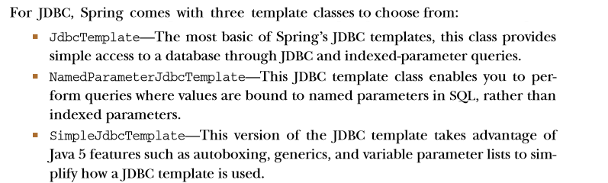
JDBC templates

Slide 24
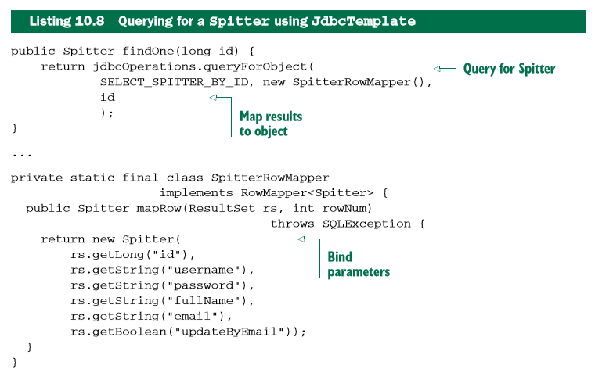
Reading data with JDBC template

Slide 25
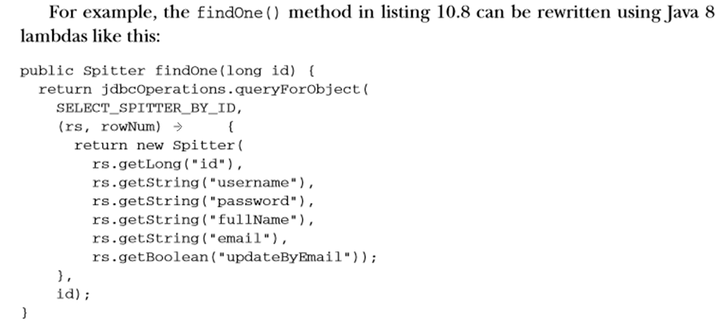
Using Java 8 Lambdas

Slide 26
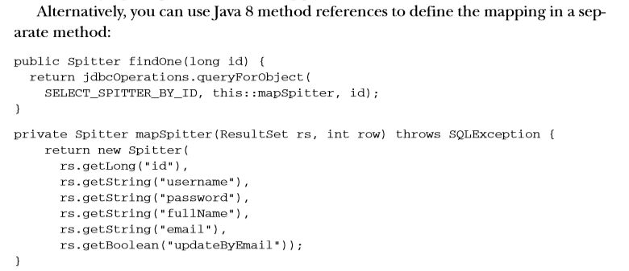
Using Java 8 Lambdas

Slide 27
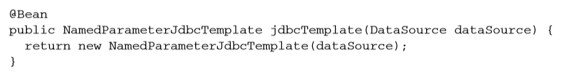
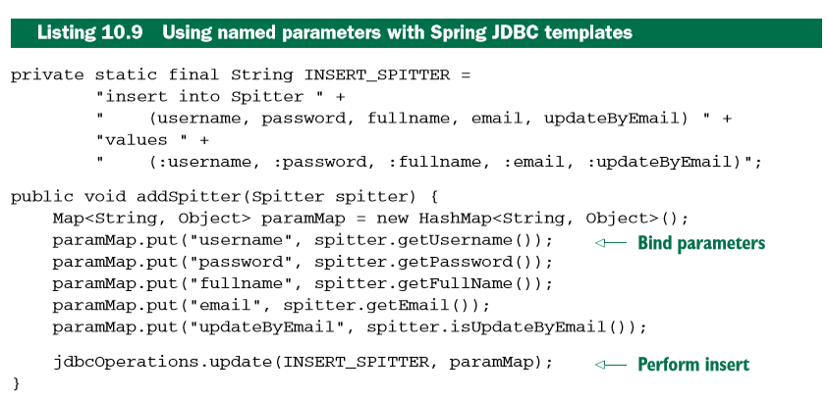
Using named parameters

Slide 28
Persisting data with object-relational mapping (ORM)

Slide 29
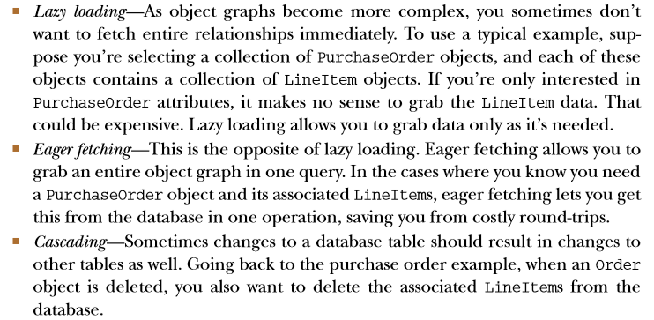
Used to create features that are more sophisticated such as:

Slide 30
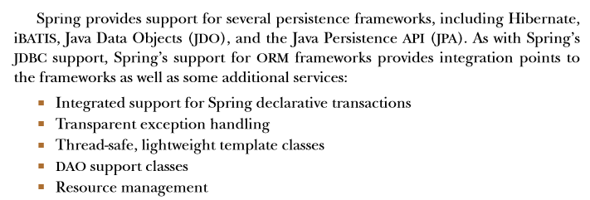

Slide 31
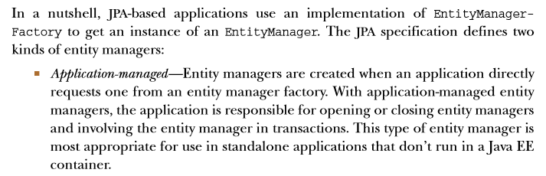
Spring and the Java Persistence API

Slide 32
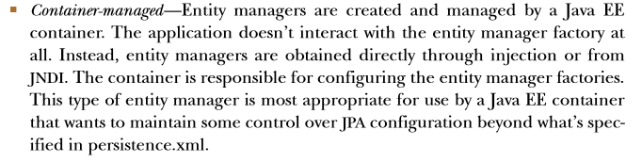
Spring and the Java Persistence API

Slide 33
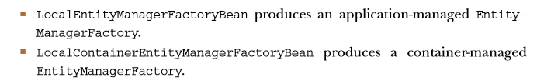
Spring and the Java Persistence API

Slide 34
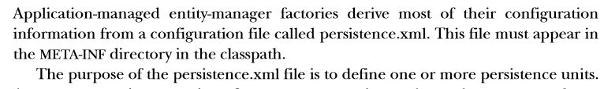
Configuring application-managed JPA

Slide 35
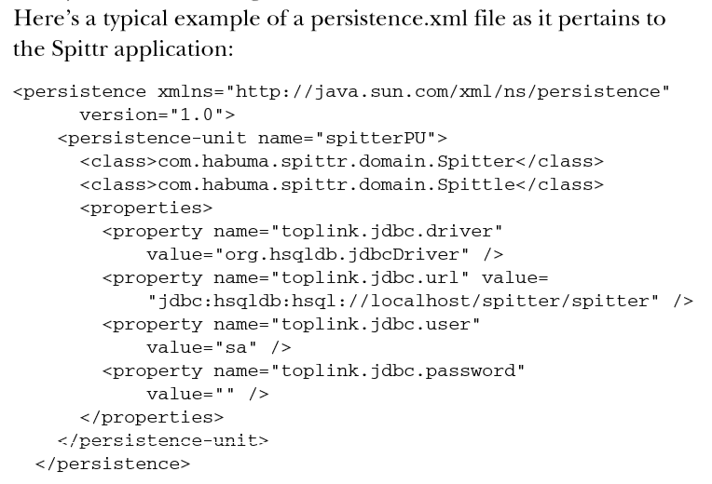
Configuring application-managed JPA

Slide 36
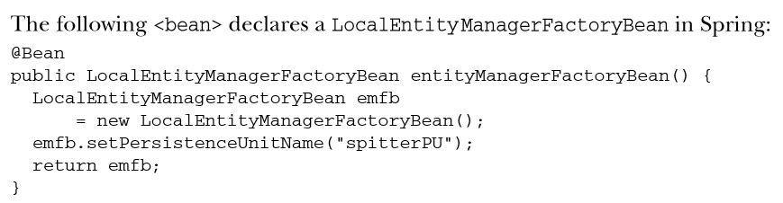
Configuring application-managed JPA

Slide 37
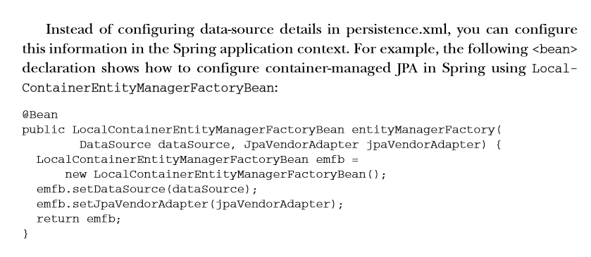
Configuring container-managed JPA

Slide 38
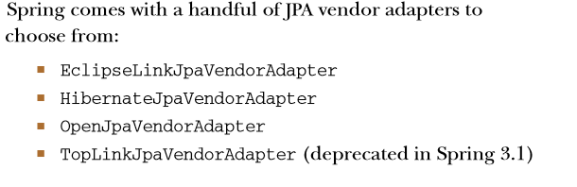
Configuring container-managed JPA

Slide 39
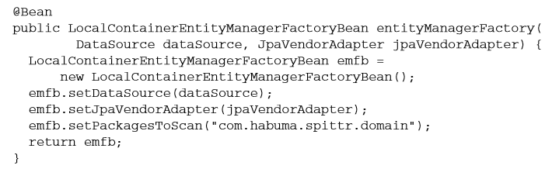
The Hibernate JPA vendor adapter

Slide 40
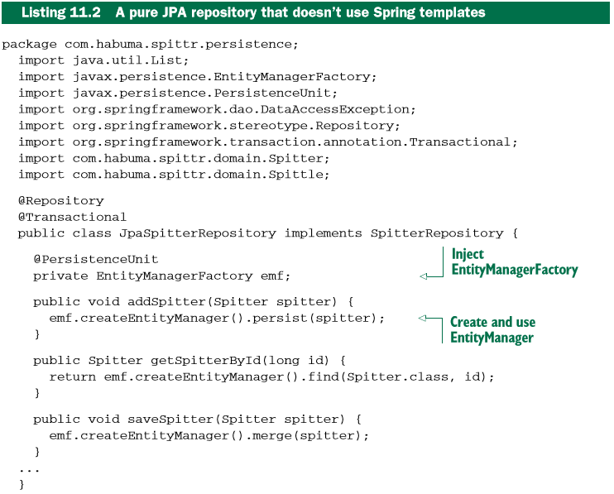
Writting a JPA-based repository

Slide 41
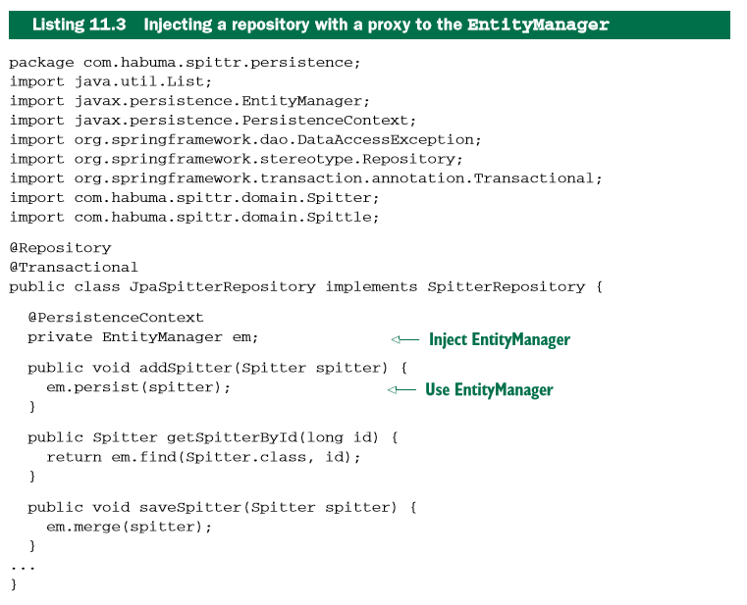
Writting a JPA-based repository

Slide 42
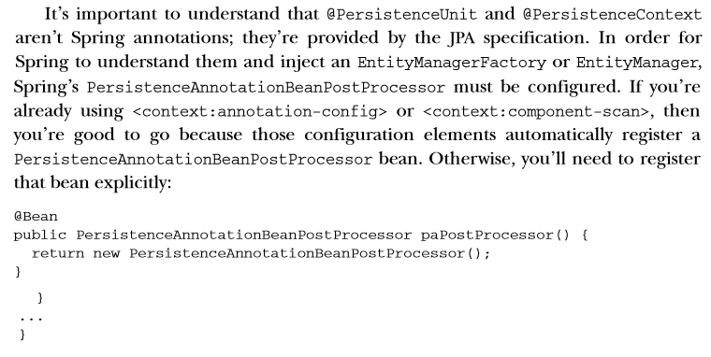
Writting a JPA-based repository

Slide 43

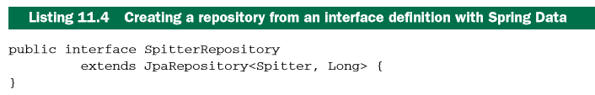
Automatic JPA repository with Spring Data

Slide 44
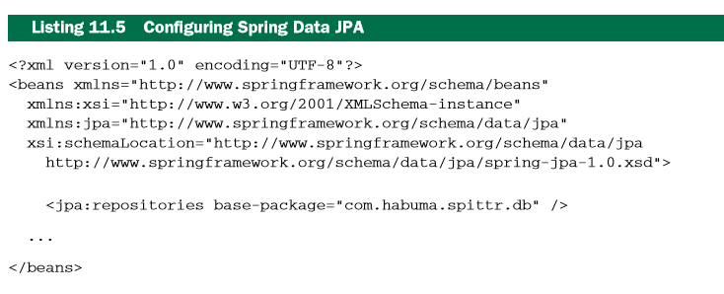
Automatic JPA repository with Spring Data

Slide 45
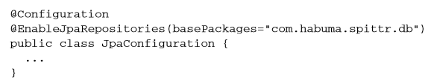
Automatic JPA repository with Spring Data
In Java-Configuration:

Slide 46
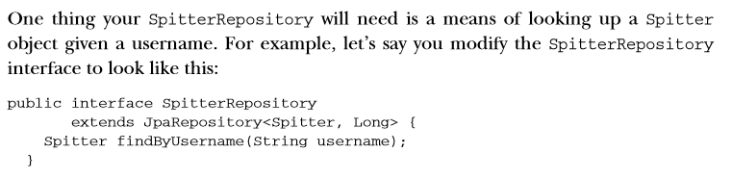
Defining query methods

Slide 47
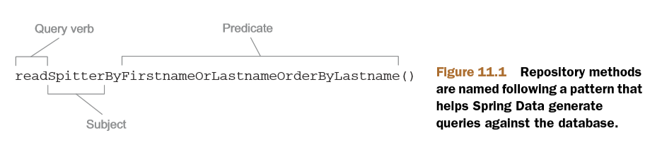
Defining query methods

Slide 48
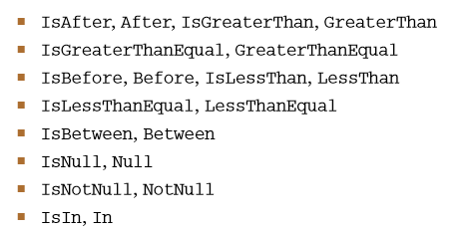
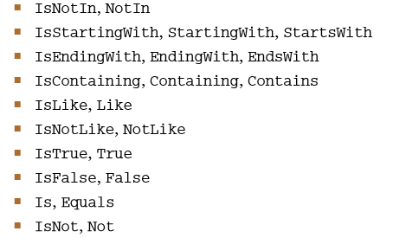
Defining query methods
Supported comparison operations:

Slide 49

Defining query methods
More examples:

Slide 50
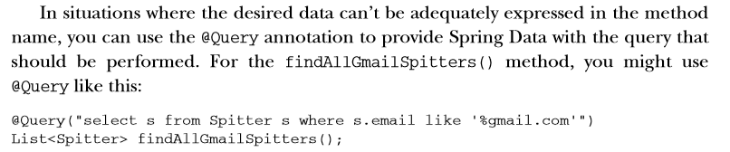
Declaring custom queries

Slide 51
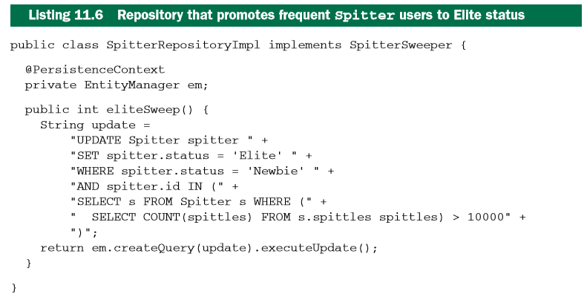
Mixing in custom functionality

Slide 52

Mixing in custom functionality

Slide 53


Mixing in custom functionality
Or in xml:

